Slide 1
Learning Vector Quantization
Metode Kuantitatif

Slide 2
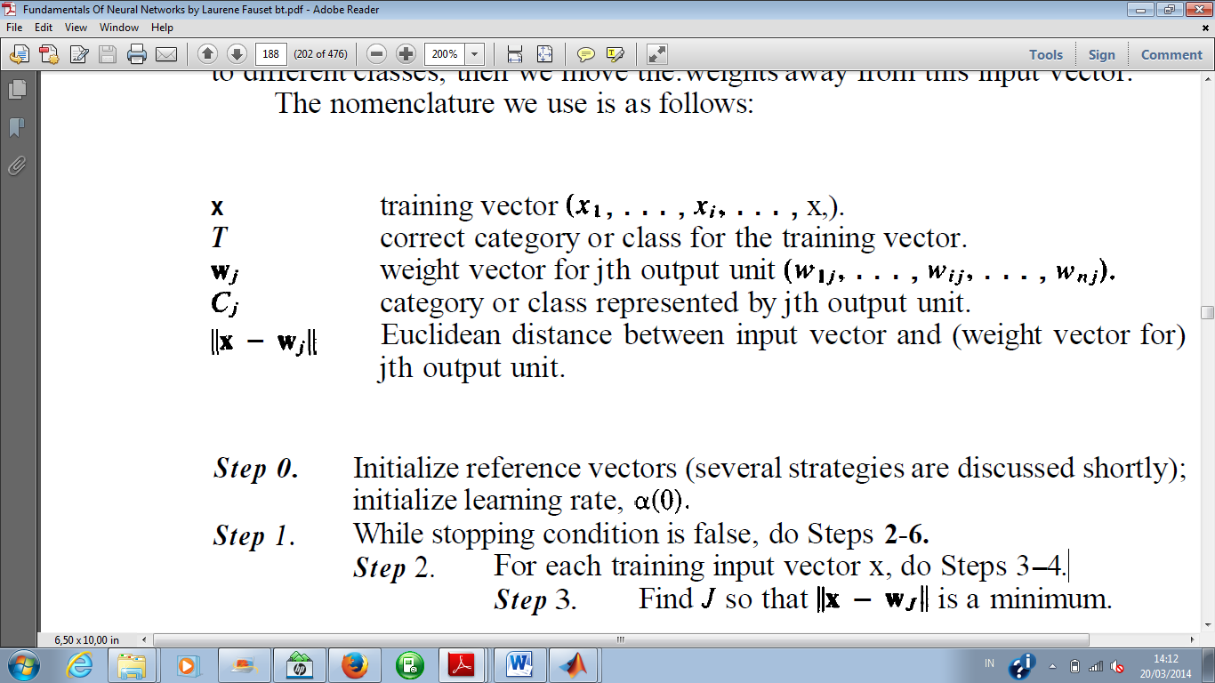

Slide 3
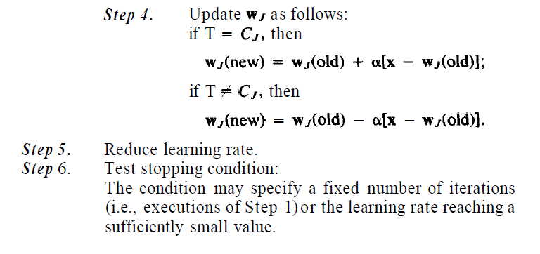
Algoritme LVQ

Slide 4
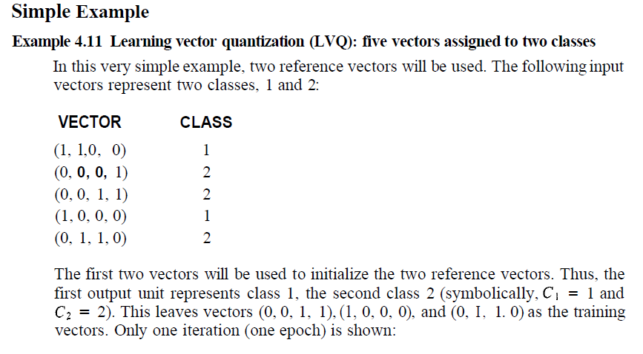

Slide 5
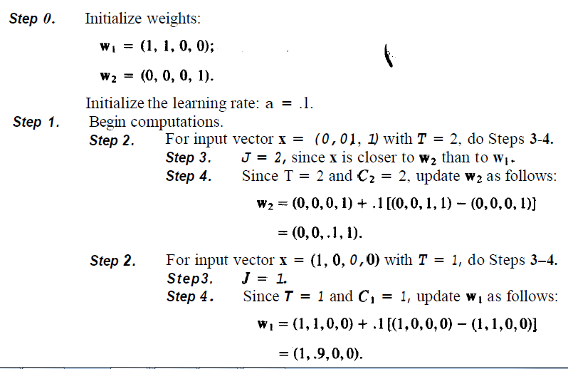

Slide 6
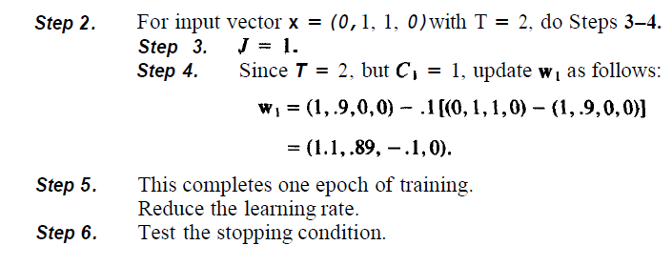

Slide 7
pustaka
Fausset L. Fundamental of neural networks.

